Slide 1
Temporal SNR (tSNR) Montage Analysis
sub003 Orange Colormap Visualization - 4 Acquisitions

Slide 2
tSNR Montage Overview
Temporal SNR Analysis with Orange Colormap:\n\n1. 2mm Resolution Scan\n • TR: Unknowns\n • Orange colormap tSNR montage\n\n2. 2mm Resolution Scan (Longer TR)\n • TR: Unknowns\n • Orange colormap tSNR montage\n\n3. 3mm Resolution Scan\n • TR: Unknowns\n • Orange colormap tSNR montage\n\n4. 2mm Resolution Scan\n • TR: Unknowns\n • Orange colormap tSNR montage\n\n

Slide 3
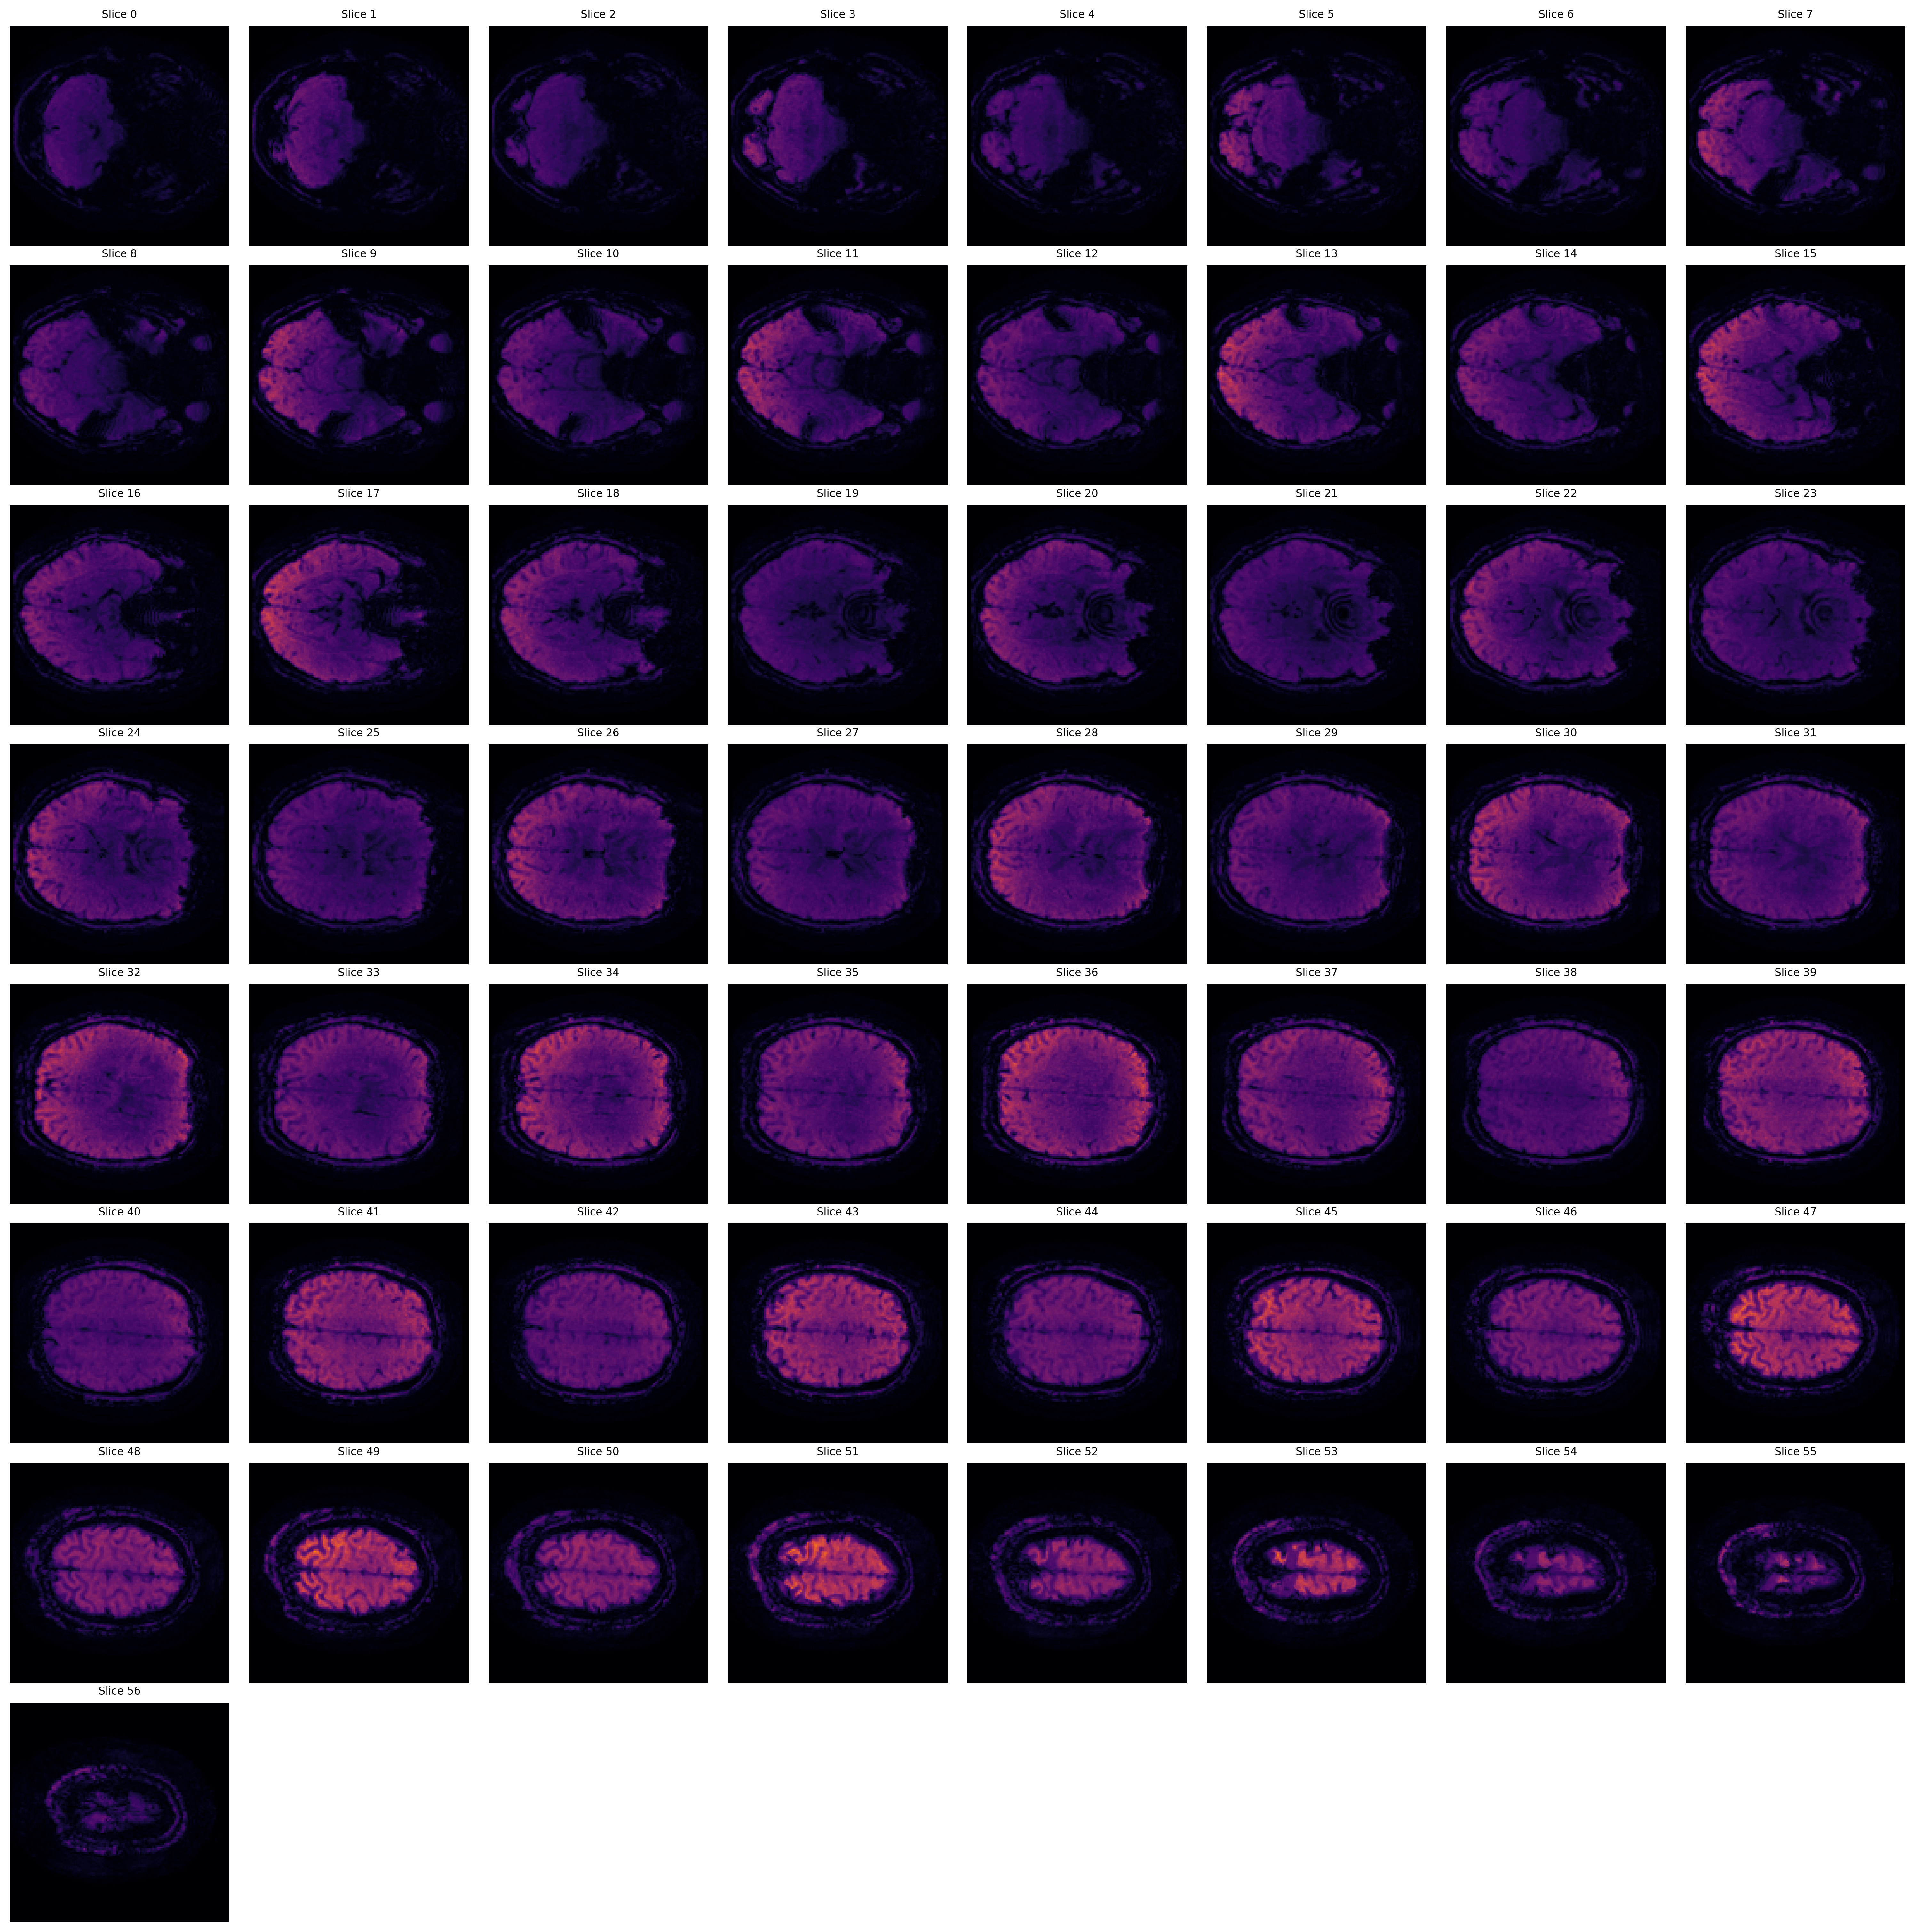
2mm Resolution Scan: Temporal SNR Montage
Temporal SNR (Ernst scaled by 1.000)

Slide 4
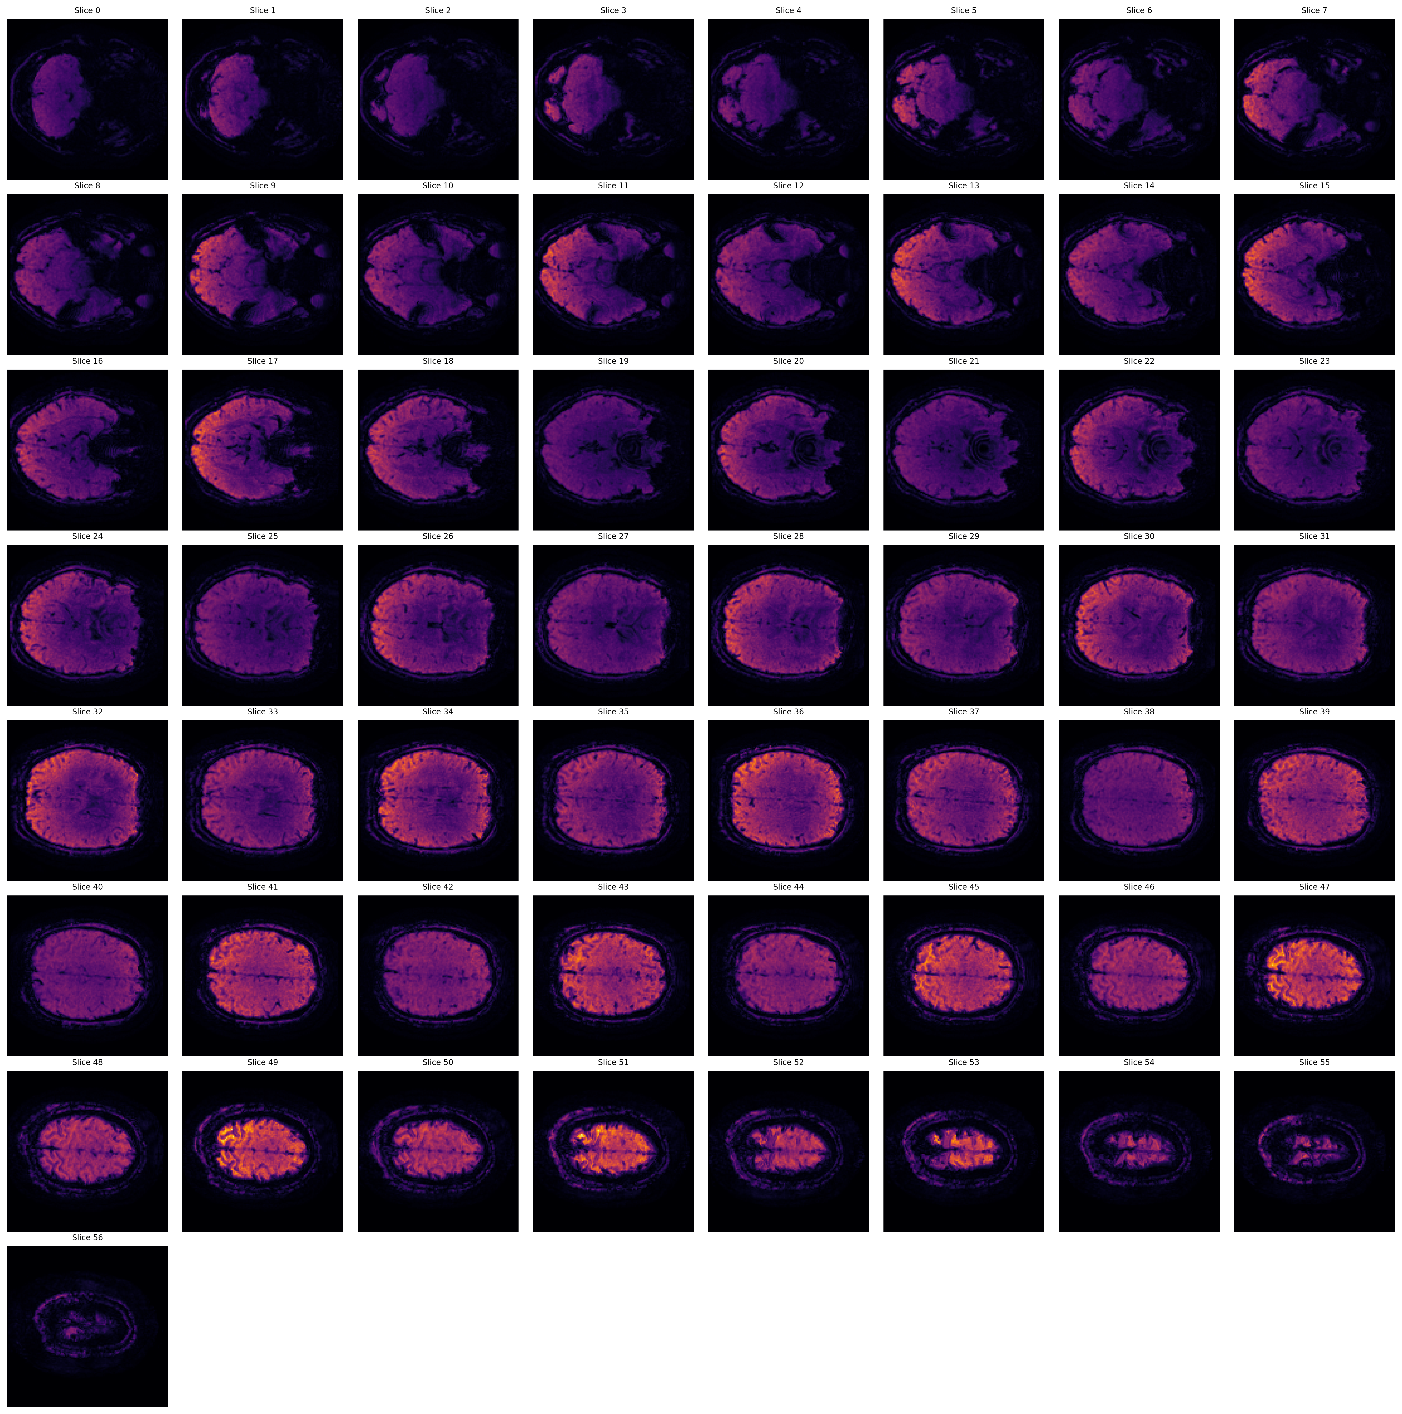
2mm Resolution Scan (Longer TR): Temporal SNR Montage
Temporal SNR (Ernst scaled by 1.000)

Slide 5
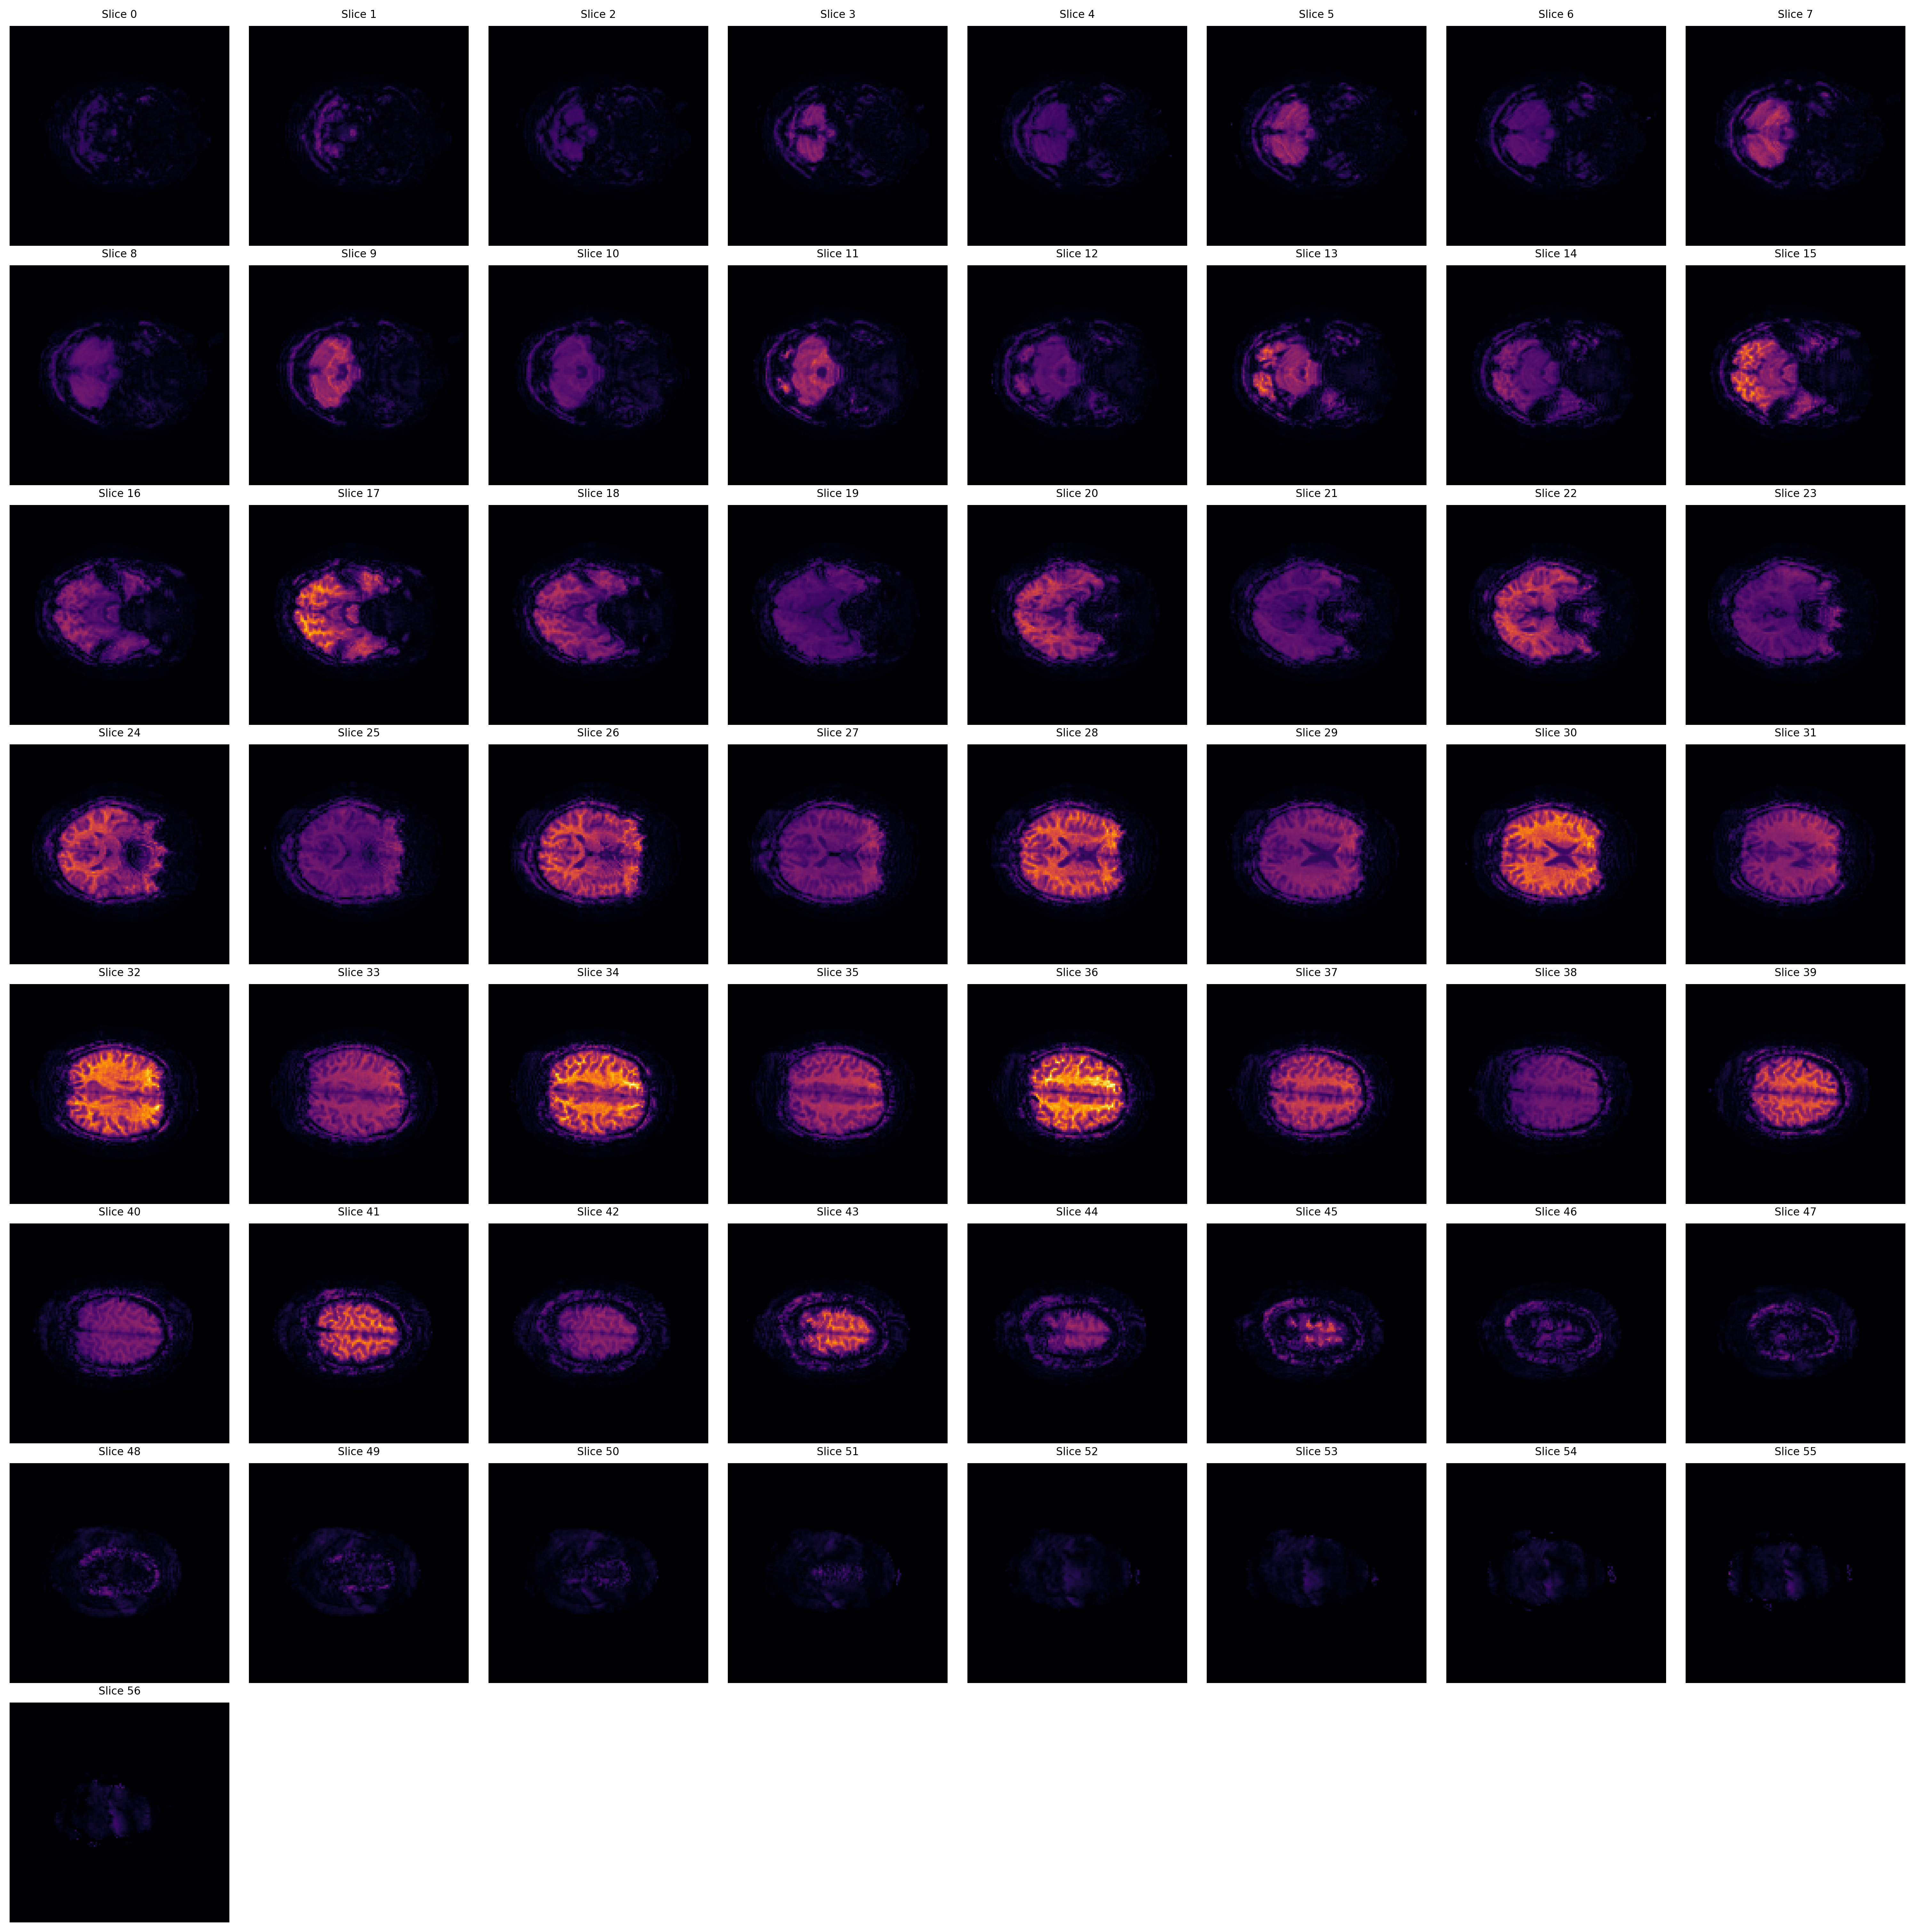
3mm Resolution Scan: Temporal SNR Montage
Temporal SNR (Ernst scaled by 1.000)

Slide 6
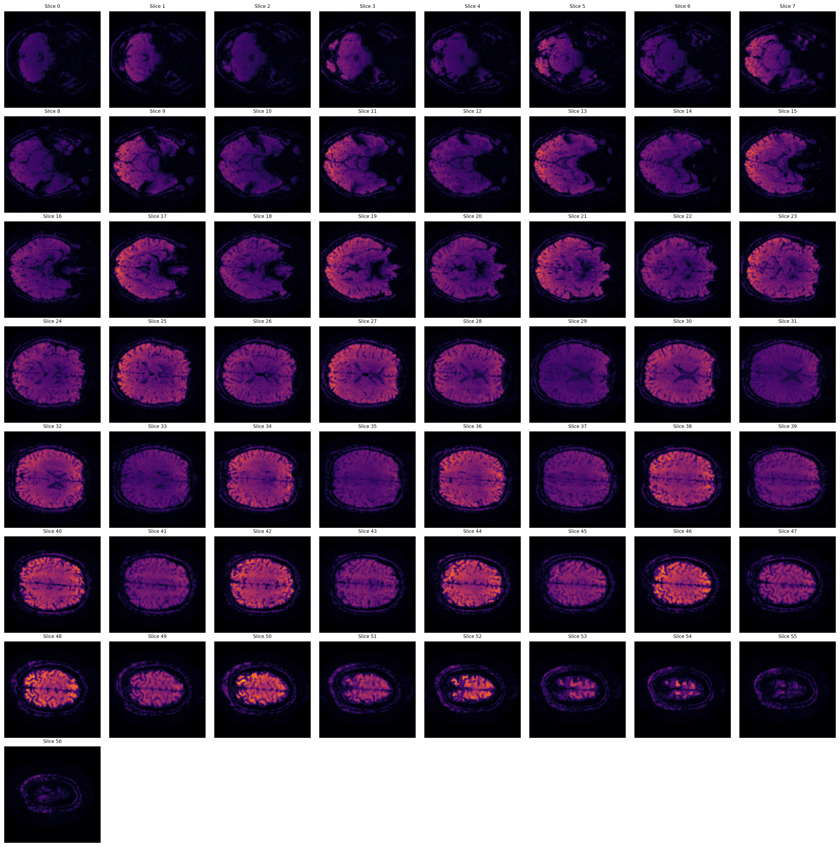
2mm Resolution Scan: Temporal SNR Montage
Temporal SNR (Ernst scaled by 1.000)

